Slide 1
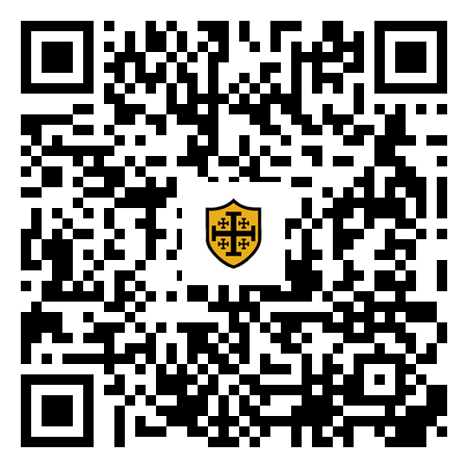

Connor T. MacIvor
AI + HI: THE MODERN REALTOR
REALTOR since 1998 · 20 years LAPD · CalDRE #01238257 · Sync Brokerage, Inc. DRE #02031490

Slide 2

"who are the best real estate agents in santa clarita"
Last Tuesday. 11:04 PM. The machine answered. You were not in the room.
Sync Brokerage, Inc.
PRESENTED TO
PRESENTED BY
SRAR Association Members
Connor T. MacIvor

Slide 3
What Is This AI Thing Anyway?
Not software. Software follows rules a programmer wrote, the same way every time. AI reads what you give it and writes back. It drafts, it sorts, it summarizes, it follows up. Fast, and it never gets tired.
It was never AI versus HI. Change one character: it is a plus sign. The machine brings speed and memory. You bring the license, the judgment, and the handshakes.

Slide 4

You Are Not Behind. You Are Invisible.

Slide 5

I Watched Them So You Do Not Have To
THE RESEARCH
59 of the most-watched YouTube videos teaching agents AI. 1.46 million combined views. 21.5 hours of teaching. 253,576 words analyzed.

Slide 6
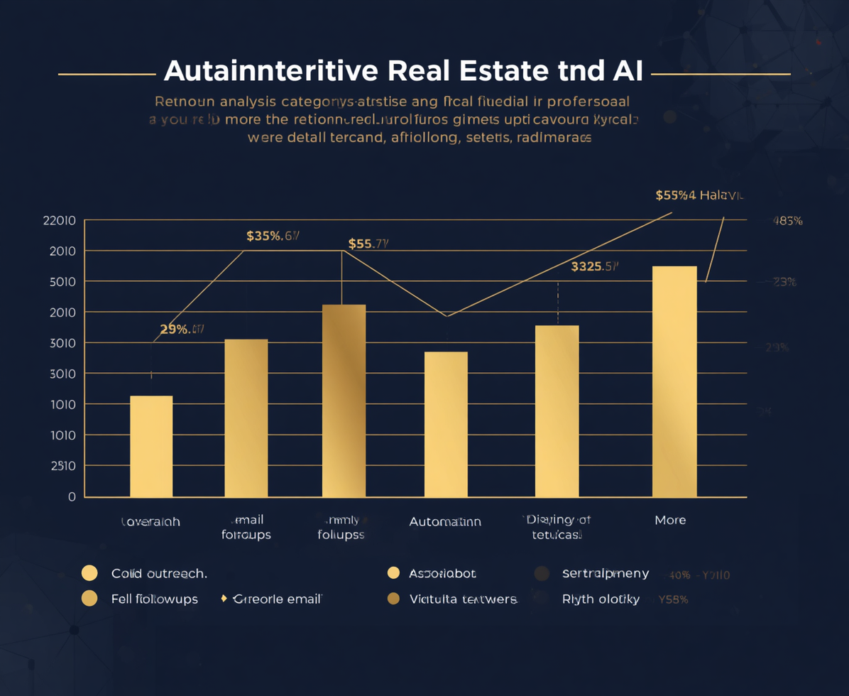


Insights from the Top AI Videos
COLD OUTREACH
EMAIL FOLLOW-UP
SOCIAL MEDIA
46 of 59 videos cover this topic.
45 of 59 videos discuss this approach.
31 of 59 videos highlight this area.

Slide 7

What 1.5 Million Views Never Told You
Fair housing: 2 of 59. Where your client data goes: 1 of 59. Verify before you send: 8 of 59. Your license: 4 of 59. Fifty-one of fifty-nine never tell you to check anything before it reaches a client.

Slide 8
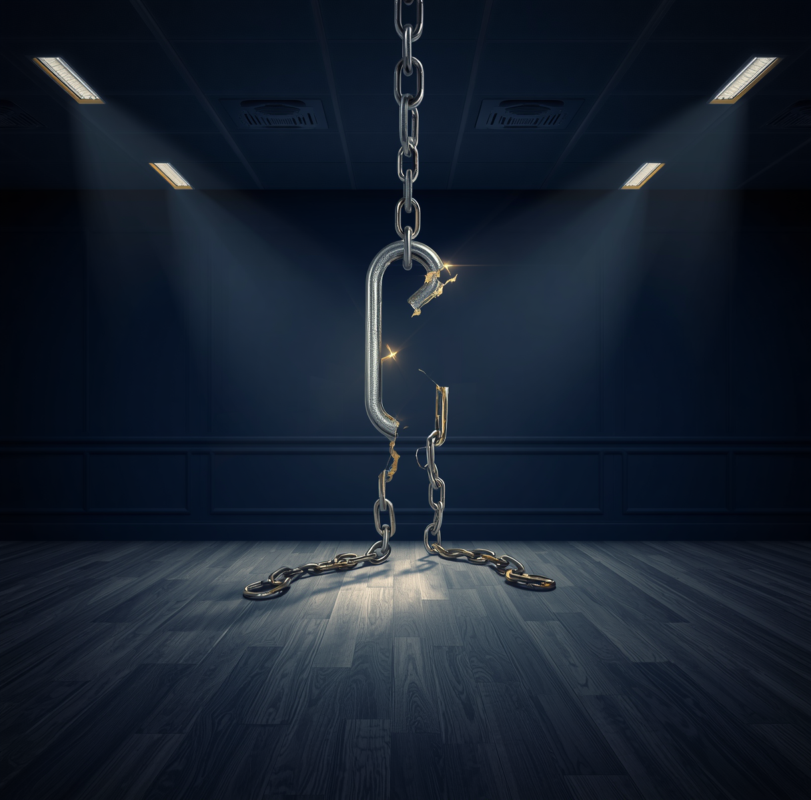
The Machine Will Break the Law For You
"Charming starter home in a safe, exclusive neighborhood, perfect for young families, walking distance to St. Mary's." Three fair housing violations. One sentence. Two seconds. Your name.

Slide 9
The Hammer Never Swings Itself
A trained professional under stress: 30% at seven feet. A master framer: a four-inch nail into redwood, one or two hits, never a miss, never a bend. Same hammer. The difference is reps. AI is the hammer. You are the swing.

Slide 10

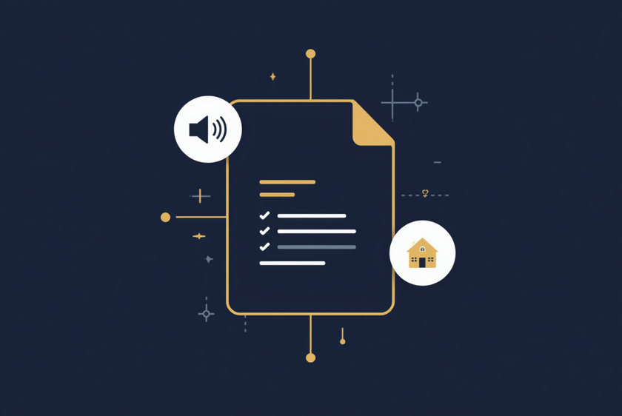
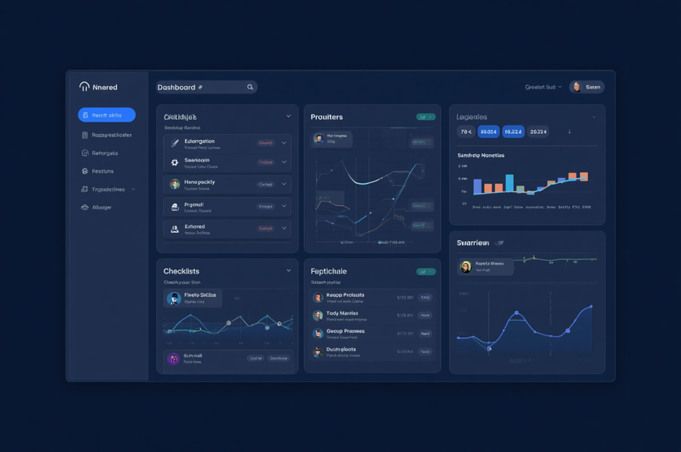
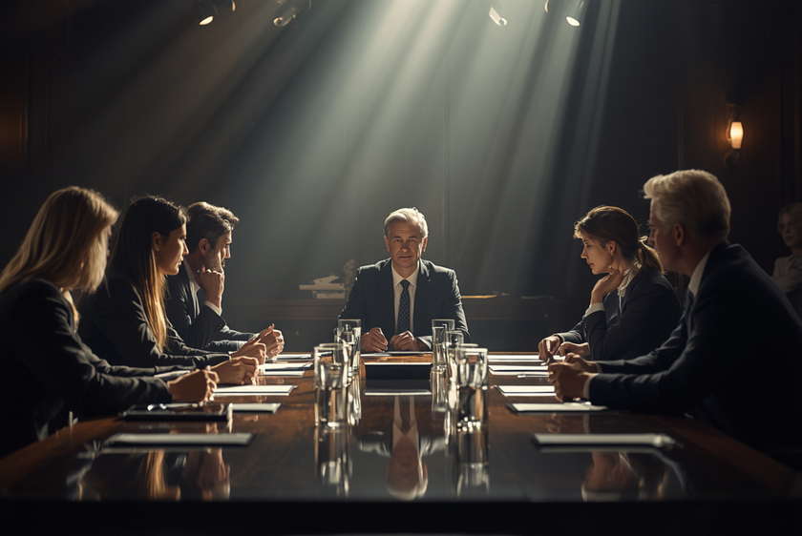
The Framer's Path to Mastery
THE VENDING MACHINE
THE CONTEXT FILE
Basic prompts yield generic, cliché results.
It understands your unique voice and needs.
NAMED SKILLS
THE BOARDROOM
Procedures defined for consistent, repeatable success.
One orchestrator leads specialized agents beneath.

Slide 11
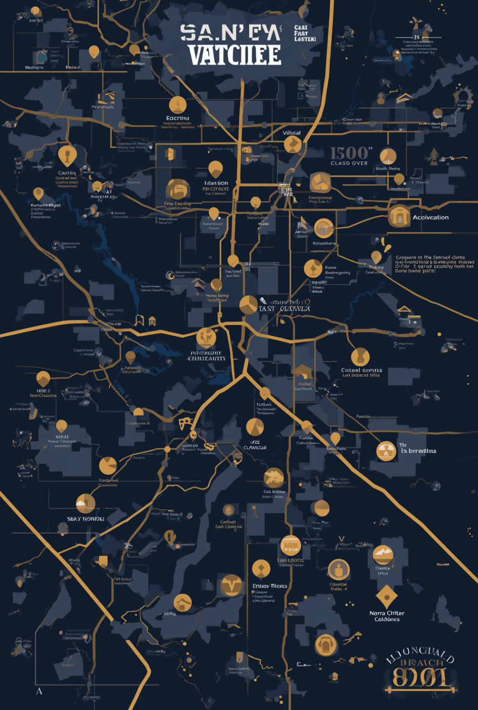
The Santa Clarita Playbook
THE JUNK DRAWER
Your dead database is your most valuable list.
CLUSTER
Segment by tract code and owner tenure.
COMPARE TO LIVE MARKET
Arrive as the data authority, not a salesperson.

Slide 12
AI Drafts. You Verify. You Sign.

Slide 13
Your First Week
01
MONDAY
02
TUESDAY
Start with one paid account, nothing else required.
Spend ten minutes on voice notes, transcribed for context.
03
WEDNESDAY
04
THURSDAY & FRIDAY
Document one skill, focusing on open house follow-up.
Connect one tool, run it, and fix any issues.

Slide 14
Same Seller. Same 11 PM.
"i am scared we are going to lose the house" No machine answers this one. You do. The machine got you into the conversation. It cannot finish it.

Slide 15
Let's Build Your Systems Together
EVERY ASSET FROM TODAY, FREE, NO EMAIL WALL
SantaClaritaArtificialIntelligence.com/SRAR0820
LICENSE
CalDRE #01238257 · Sync Brokerage, Inc. DRE #02031490
PHONE
661-400-1720

